Slide 1

Don’t Be Pressured:
Understanding Blood Pressure
From the American Heart Association
Locally Sponsored by

Slide 2
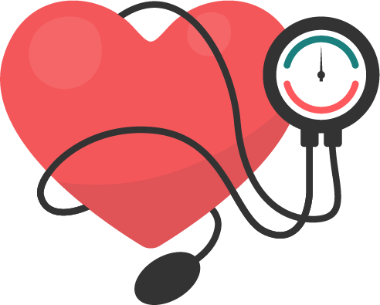
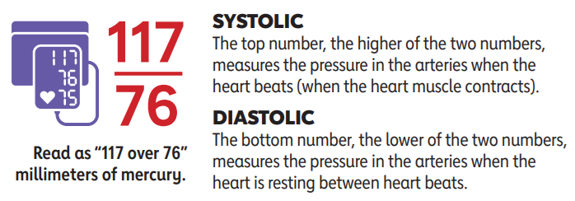
What is Blood Pressure?
Blood pressure is the force of blood against the arteries when the heart beats and rests.
Blood pressure is typically recorded as two numbers, written as a ratio like this:
Notes:
SOURCE
https://www.heart.org/en/healthy-living/healthy-lifestyle/lifes-essential-8/how-to-manage-blood-pressure-fact-sheet

Slide 3
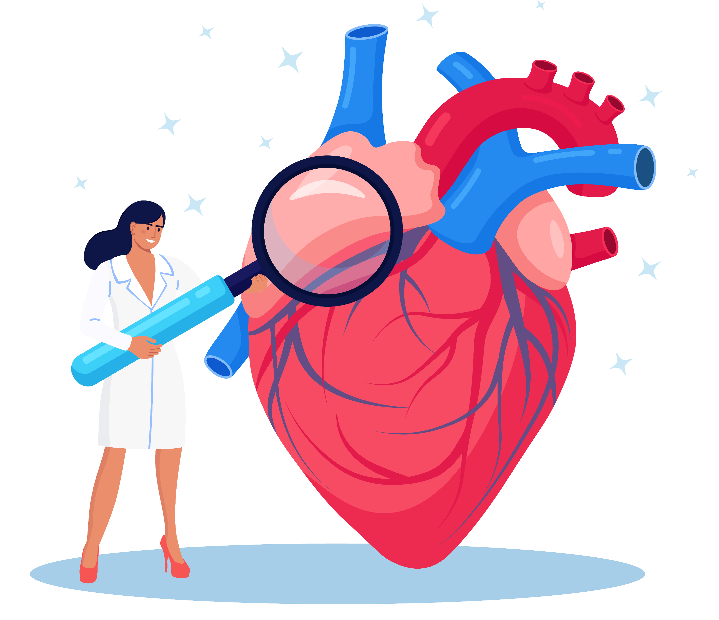
How Does High Blood Pressure
Affect Your Health?
High blood pressure (hypertension) can harm heart and brain health and usually has no symptoms.
It damages blood vessels and cause other health problems, like: heart attack, stroke, dementia, heart failure, kidney disease/failure, and vision loss.
Notes:
SOURCE
https://www.heart.org/en/healthy-living/healthy-lifestyle/lifes-essential-8/how-to-manage-blood-pressure-fact-sheet

Slide 4
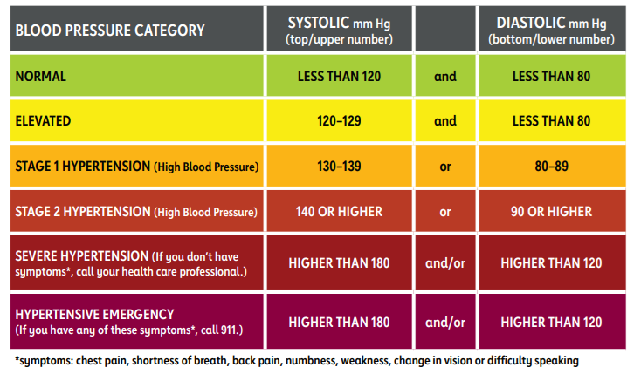
Blood Pressure Chart
Blood pressure numbers of less than 120/80 mm Hg are considered within the normal range for non-pregnant individuals.
Notes:
SOURCE
https://www.heart.org/en/healthy-living/healthy-lifestyle/lifes-essential-8/how-to-manage-blood-pressure-fact-sheet

Slide 5
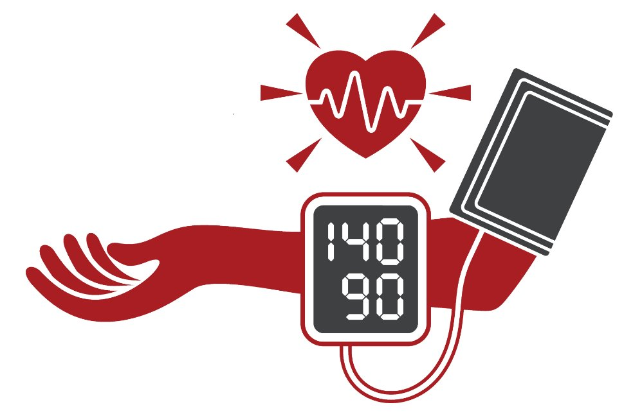
How Often Should I Check My Blood Pressure?
High blood pressure is often called the “Silent Killer” because it can have no symptoms.
That’s why it’s important to get your blood pressure checked at least once a year, but regularly monitoring at home is recommended. Measure twice in the morning and twice in the evening.
Some pharmacies, health clinics and fire stations have free monitoring stations.
A high blood pressure diagnosis must be confirmed by a health care professional.
Notes:
SOURCE
https://www.heart.org/en/healthy-living/healthy-lifestyle/lifes-essential-8/how-to-manage-blood-pressure-fact-sheet
https://www.goredforwomen.org/en/know-your-risk/know-your-numbers/key-numbers-to-know-for-your-heart-health-infographic

Slide 6
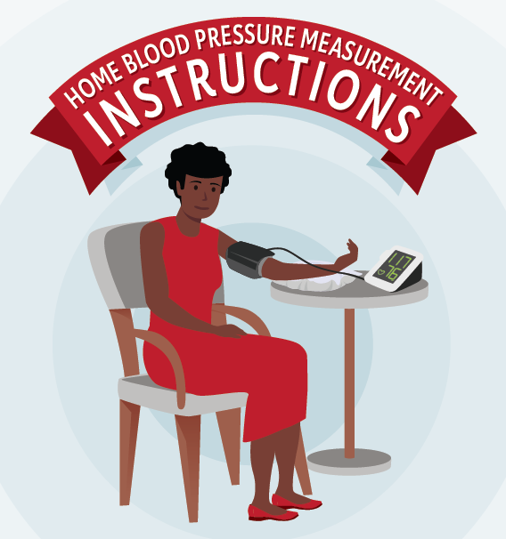
HOME BLOOD PRESSURE MEASUREMENT INSTRUCTIONS
Before You Measure
No smoking, caffeinated beverages, alcohol, or exercise 30 minutes prior.
Use a validated device with the correct cuff size (visit validatebp.org to find a device you can trust).
Empty your bladder.
Sit quietly for more than 5 minutes and do not talk.
Proper Positioning
Sit upright with back supported, feet on floor, and legs uncrossed.
Rest your arm comfortably on a flat surface at heart level.
Wrap the cuff on your bare skin above the bend of the elbow, not over clothing.
During Measurement
Stay relaxed and do not talk.
Take at least two readings, 1 minute apart.
Record all results once measurement is completed and share them with your health care professional to help confirm your office blood pressure category.
Notes:
SOURCE
https://www.goredforwomen.org/en/know-your-risk/high-blood-pressure-and-women/how-to-monitor-blood-pressure-at-home-infographic

Slide 7

High Blood Pressure Emergencies
Blood pressure higher than 180/120 mm Hg may be a hypertensive emergency.
Wait a few minutes and take blood pressure again.
If your blood pressure is still high and there are no other signs or symptoms, contact your health care professional.
If you are experiencing signs of possible organ damage, such as chest pain, shortness of breath, back pain, numbness/weakness, change in vision or difficulty speaking, call 911.
Notes:
SOURCE
https://www.goredforwomen.org/en/know-your-risk/high-blood-pressure-and-women/how-to-monitor-blood-pressure-at-home-infographic

Slide 8
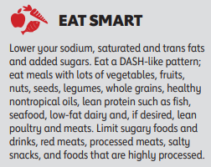
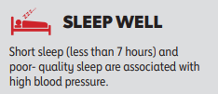
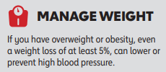
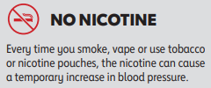

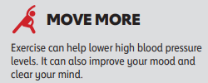
Ways to Improve Your Blood Pressure
Notes:
SOURCE
https://www.heart.org/en/healthy-living/healthy-lifestyle/lifes-essential-8/how-to-manage-blood-pressure-fact-sheet

Slide 9
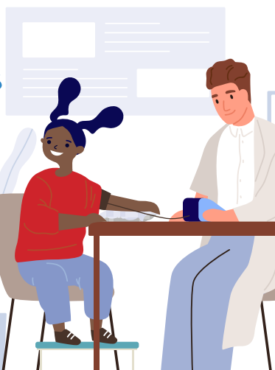
What About Blood Pressure in Children?
A healthy blood pressure range for your child depends on three factors: gender, age, and height. Talk to your child’s pediatrician about appropriate numbers for your child and how to manage them.
Children ages 3 and older have yearly blood pressure checks for early detection and treatment. Children younger than 3 may need blood pressure checks if they have a high-risk condition.
Notes:
SOURCE
https://www.heart.org/en/health-topics/high-blood-pressure/know-your-risk-factors-for-high-blood-pressure/high-blood-pressure-in-children

Slide 10

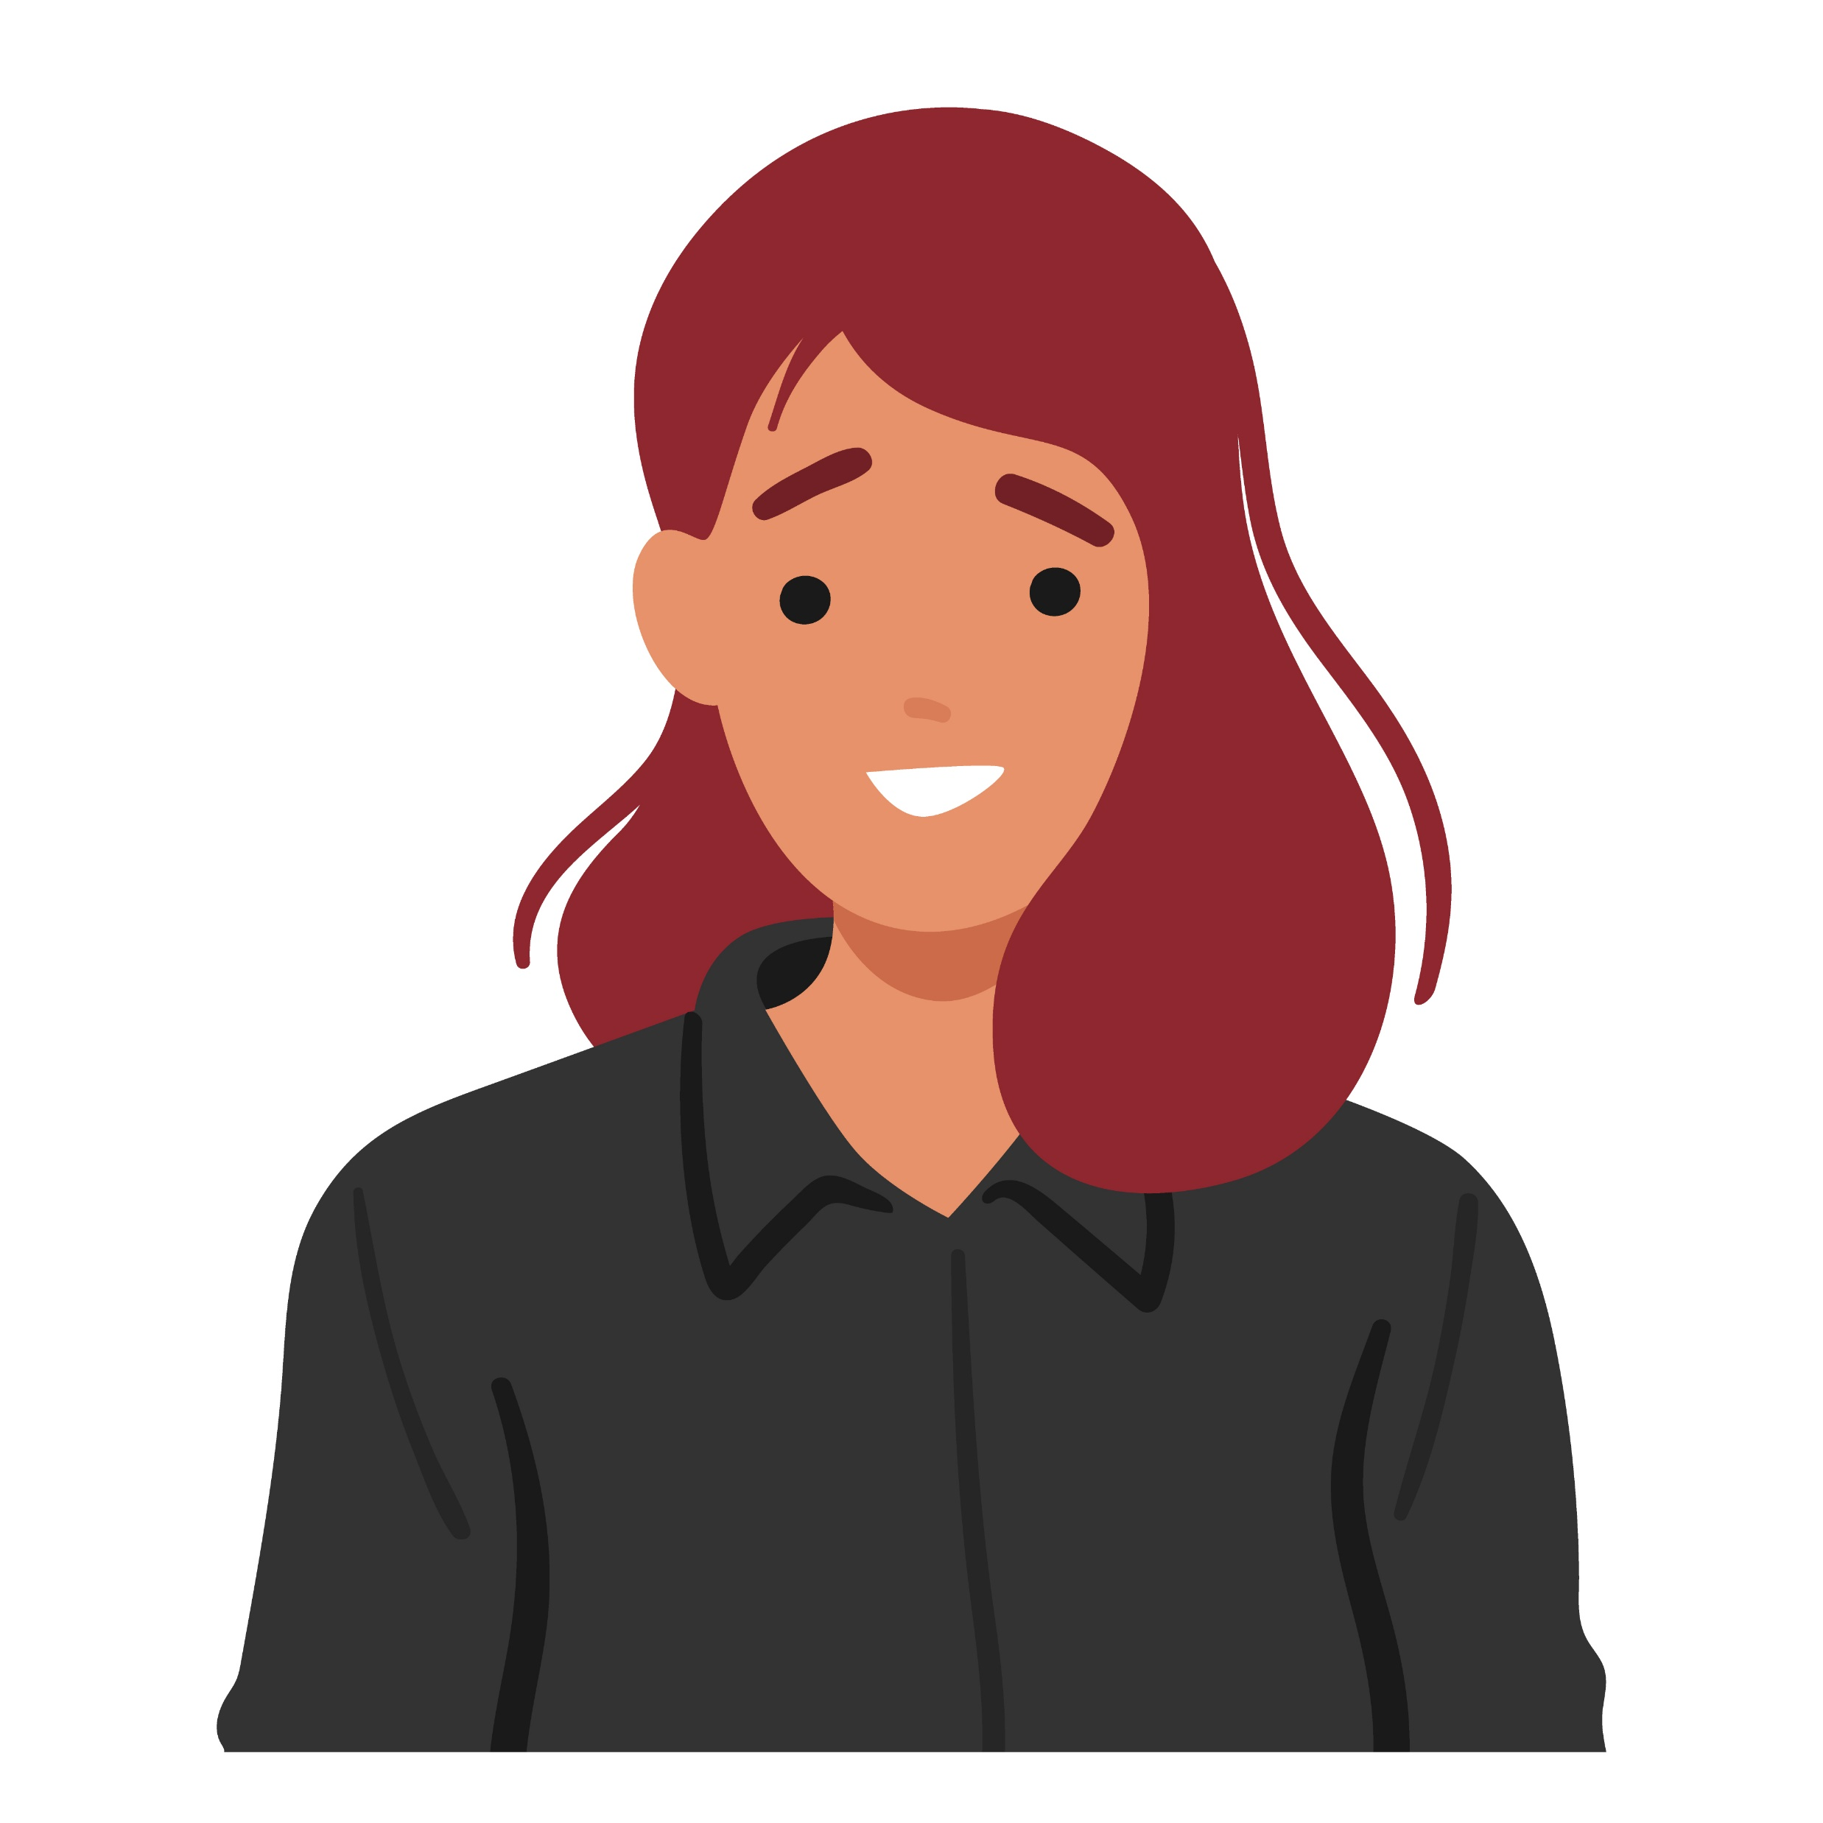
How to Talk to Kids About Blood Pressure
Blood pressure is how strongly blood goes through tubes in your body to give you energy. It’s like how pipes carry water in a house!
When our heart pumps blood, it pushes the blood through tubes, and that’s how it brings oxygen and nutrients to all the parts of our body.
Sometimes, when we eat too much salty or fatty foods or don’t get enough exercise, our tubes can become narrow and tight. It’s like when a straw gets squished a bit. When that happens, it makes it harder for the blood to flow smoothly through the tubes.
It’s like when we squeeze a water hose, and the water squirts out with more force. That extra pressure on our blood vessels is called high blood pressure and makes our hearts work extra hard. We want our heart to stay strong, but having high blood pressure can make it tired.
Notes:
SOURCE
https://www.heart.org/-/media/Healthy-Living-Files/LE8-Fact-Sheets/For-Kids/lifes_essential_8__for_kids_dont_be_pressured.pdf?sc_lang=en

Slide 11
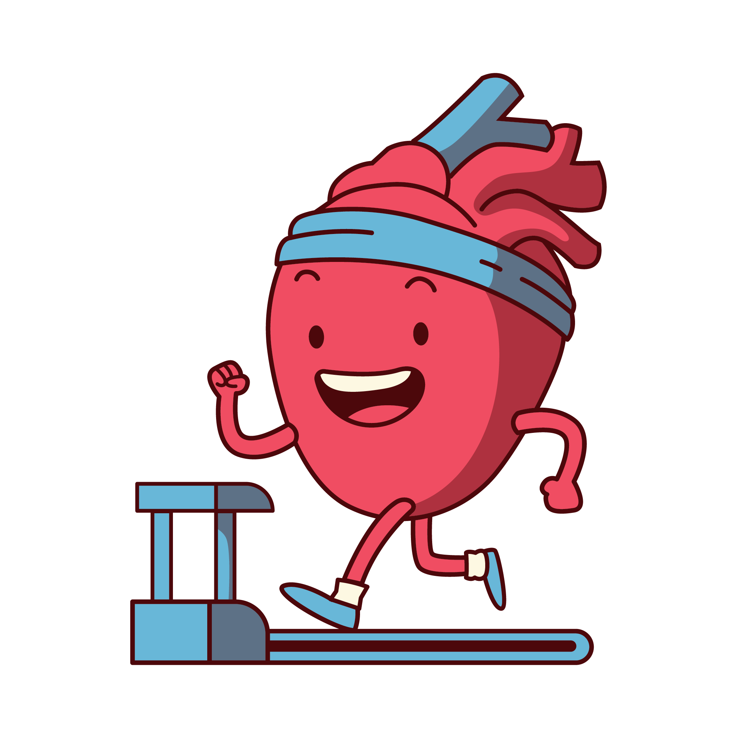
Manage Blood Pressure Together
Make sure everyone in the family gets their blood pressure checked!
Choose, plan, and prep healthy meals together.
Make physical activity a habit – finds way to get active together that you all enjoy.
Remind kids about the dangers of tobacco and that it’s never too early to have healthy habits.

Slide 12
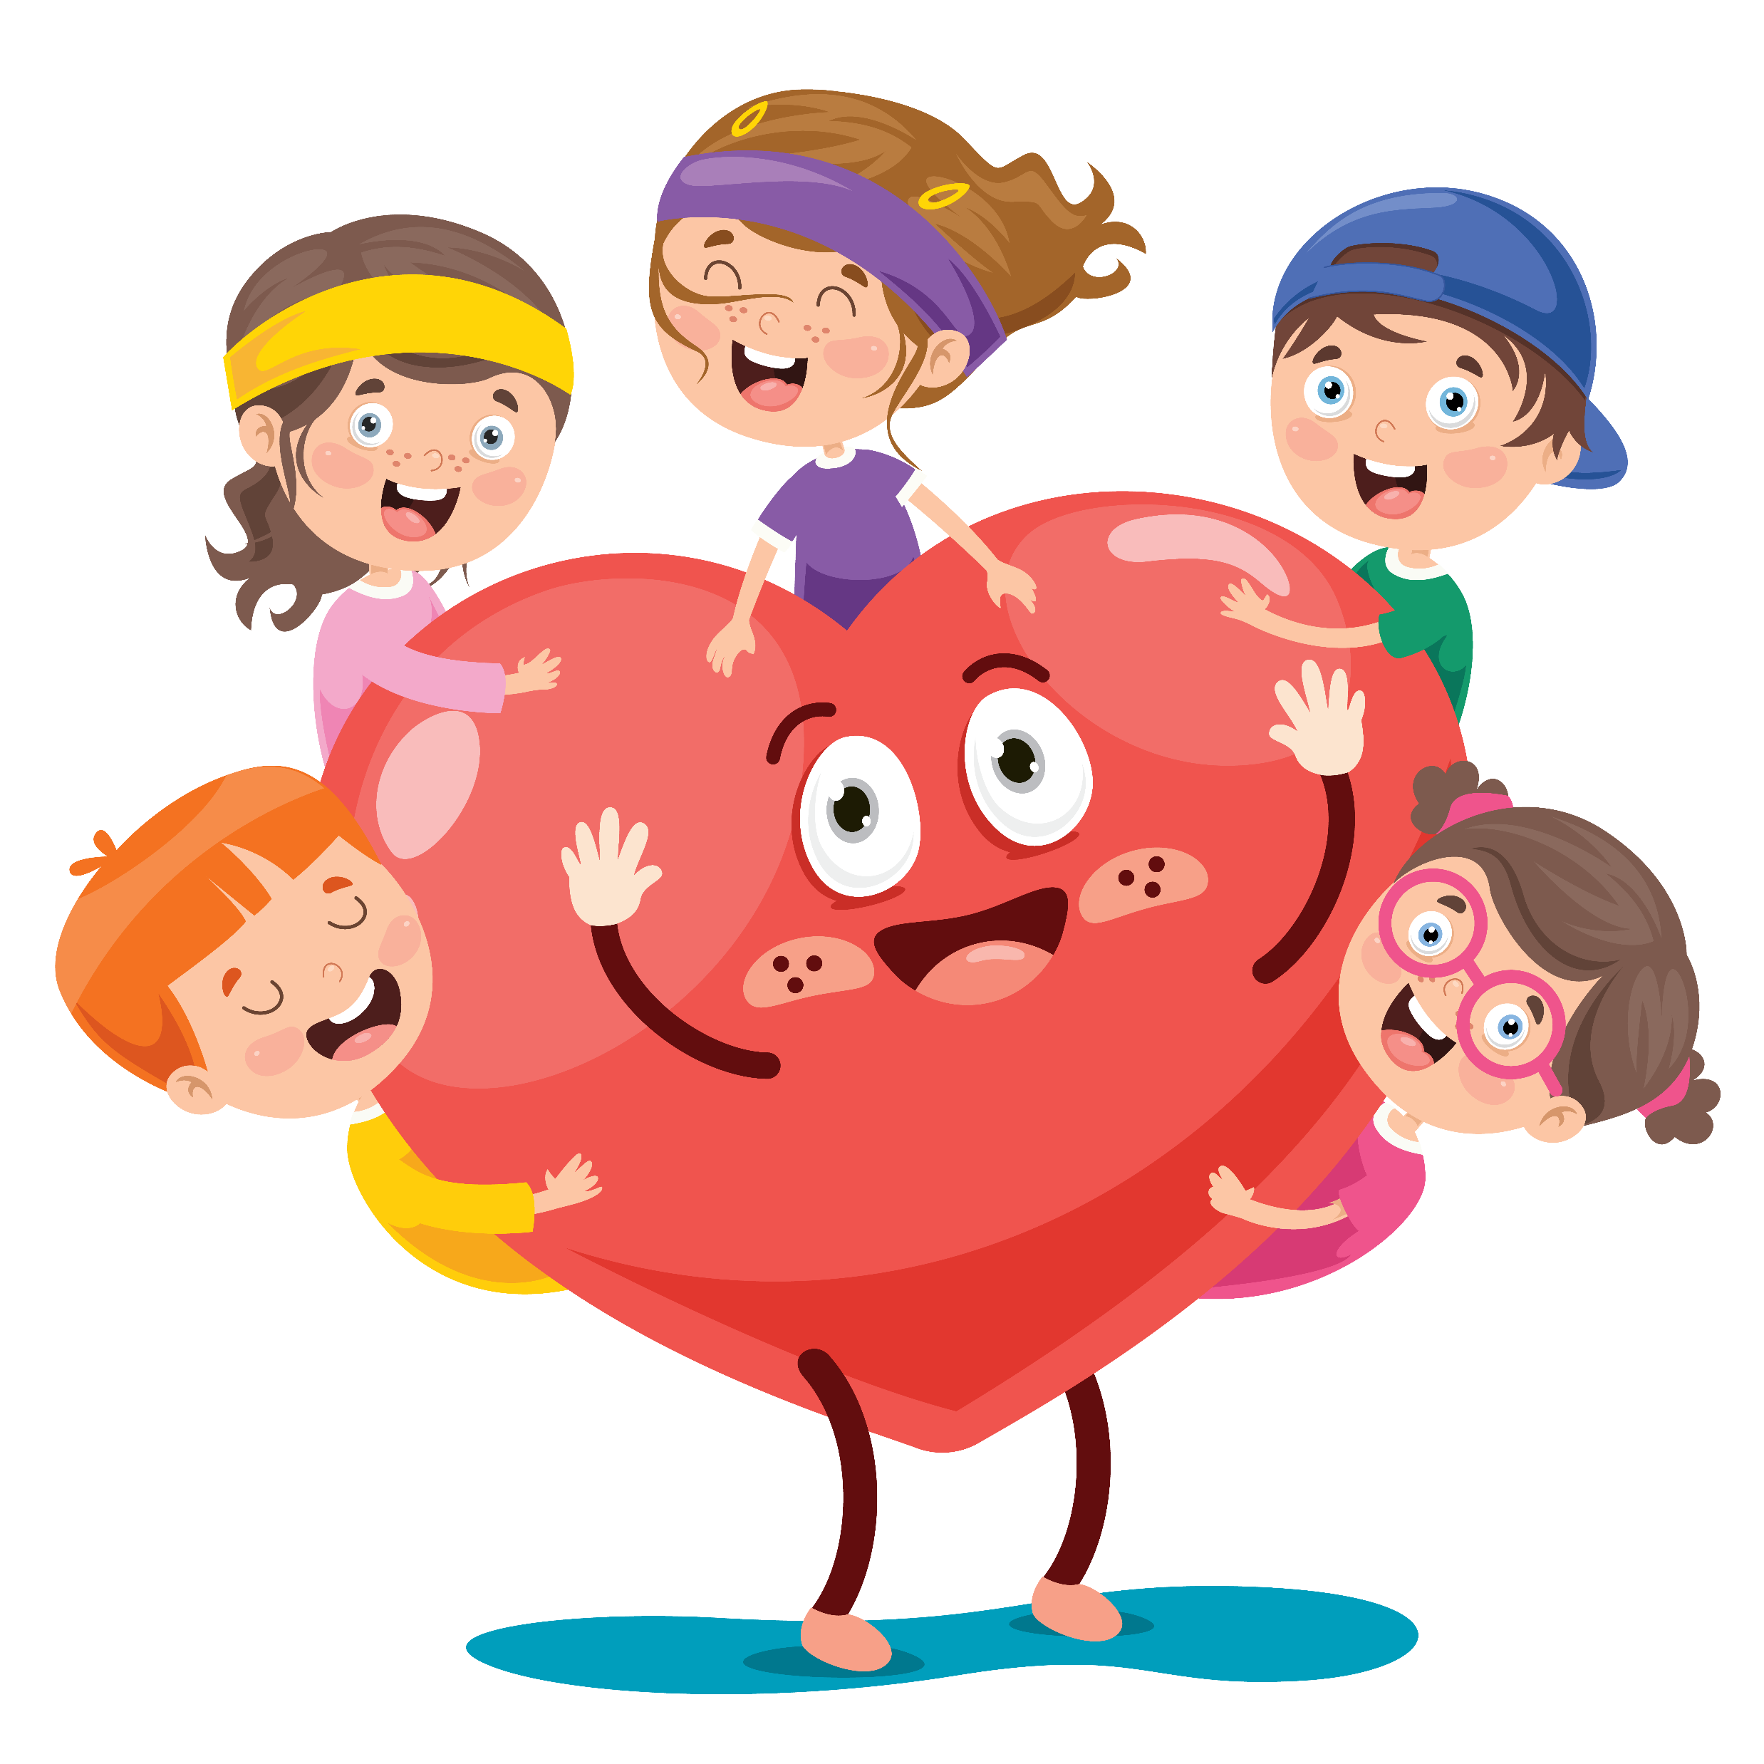
Wrap Up
High blood pressure (hypertension) is dangerous to heart and brain health.
It’s usually has no symptoms – it’s very important to get your blood pressure checked.
Develop healthy habits like eating smart and moving more as a family!

